Slide 1
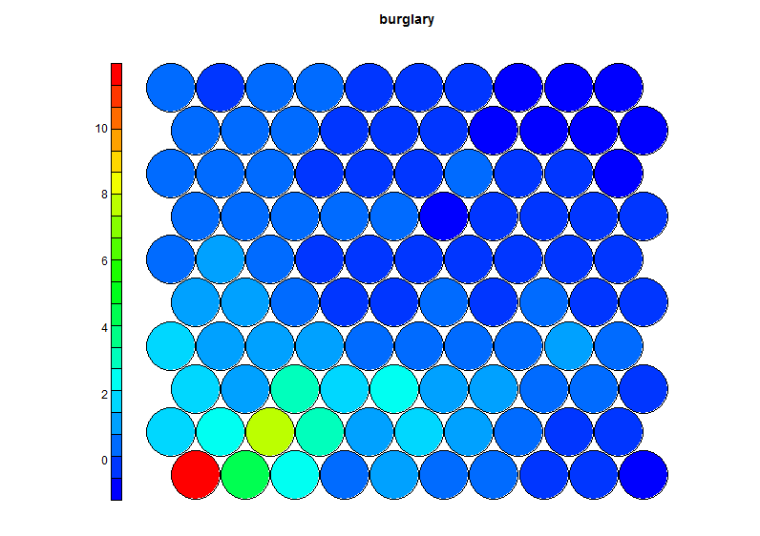
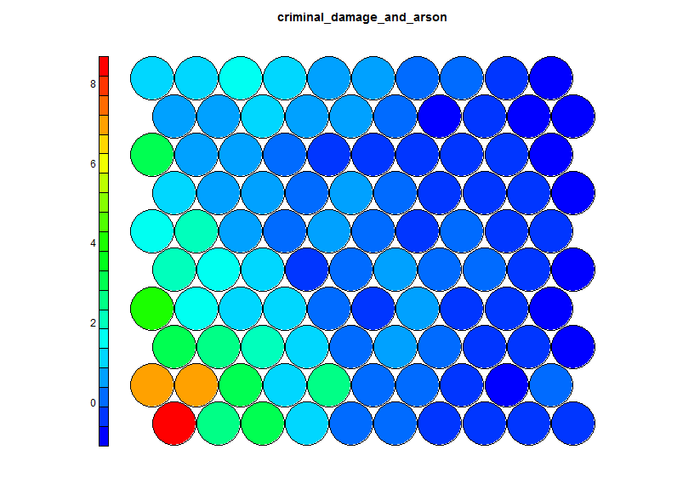
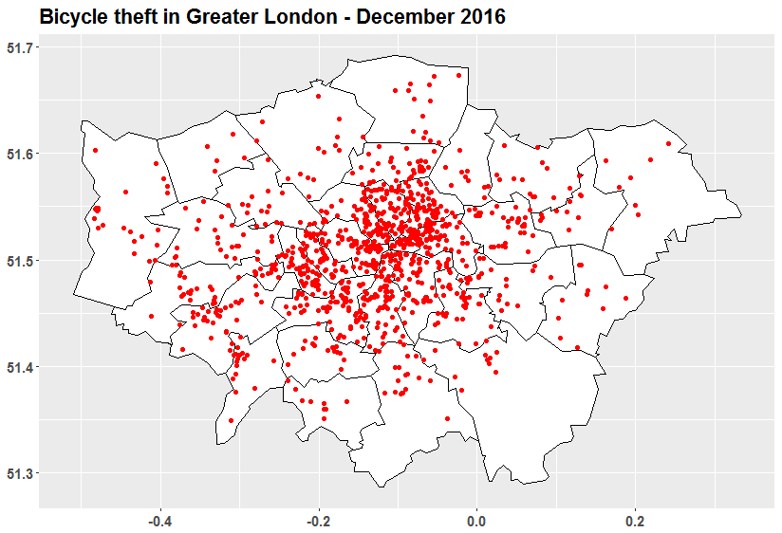
Mapping London’s crime with Shiny web applications built in R and Self-Organising Maps (SOMs)

Slide 2
Data
https://data.police.uk/
Comes as separate csv files for each month
Script to import each csv, clean, combine and transform into appropriate format

Slide 3
Part 1: GIS mapping in R
Data: 988,848 incidences represented by each row
Month
Longitude
Latitude
Crime type
14 types of crime
Month | Longitude | Latitude | Crime.type
2016-01 | -0.11242 | 51.51538 | Anti-social behaviour
2016-01 | -0.11495 | 51.51863 | Anti-social behaviour
2016-01 | -0.1115 | 51.51823 | Anti-social behaviour
2016-01 | -0.11495 | 51.51863 | Anti-social behaviour
2016-01 | -0.11377 | 51.51737 | Other theft

Slide 4
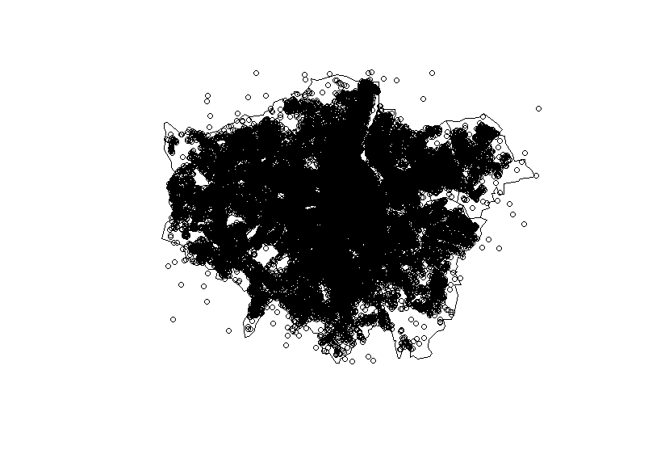
Plotting all crimes in Greater London

Slide 5
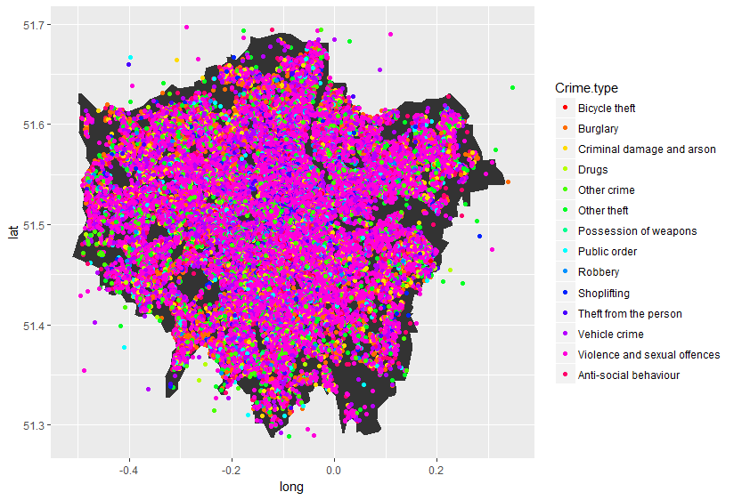
Differentiate between the different types of crime

Slide 6
Easier to visualise one type of crime

Slide 7
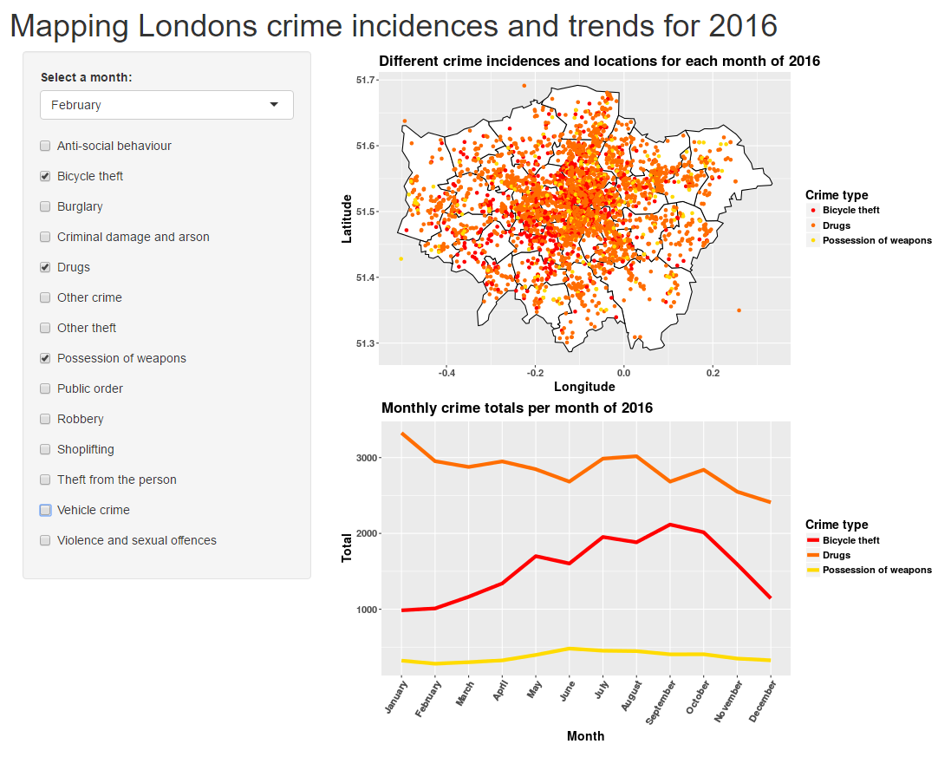
Turn it into an interactive Shiny application
Toggle crimes and select different months.
View each crimes trend by month over the year

Slide 8
Part 2: Self-Organising Maps
Segmentation of areas by types of crime
Data: wide format 5,149 areas as the dependant variable represented by each row
14 types of crime as the independent variables
LSOA_name | anti_social_behaviour | bicycle_theft | burglary | criminal_damage_and_arson | drugs | other_crime | other_theft | possession_of_weapons | public_order | robbery | shoplifting | theft_from_the_person | vehicle_crime | violence_and_sexual_offences
Camden 028B | 386 | 72 | 111 | 47 | 19 | 12 | 476 | 4 | 53 | 23 | 64 | 143 | 76 | 171
City of London 001A | 47 | 38 | 6 | 5 | 7 | 5 | 81 | 0 | 6 | 2 | 17 | 25 | 20 | 15
City of London 001B | 95 | 26 | 6 | 10 | 9 | 1 | 53 | 0 | 9 | 0 | 10 | 24 | 3 | 23
City of London 001C | 13 | 4 | 0 | 3 | 3 | 0 | 2 | 1 | 1 | 0 | 0 | 11 | 0 | 8
City of London 001E | 126 | 17 | 34 | 23 | 38 | 13 | 100 | 3 | 23 | 2 | 4 | 29 | 19 | 96

Slide 9
Train the SOM
Select dimension of SOM: 10 x10 = 100 nodes
Select the number of learning iterations (rlen): 400
trainSOM <- function(dims, lrn, file, folder) {
dataTrainMatrix <- as.matrix(scale(dataTrain))
somGrid <- somgrid(xdim = dims[1], ydim = dims[2], topo = "hexagonal")
model <- som(dataTrainMatrix,
grid = somGrid,
rlen = lrn,
alpha = c(0.05,0.01),
keep.data = TRUE)
return(model)
}

Slide 10
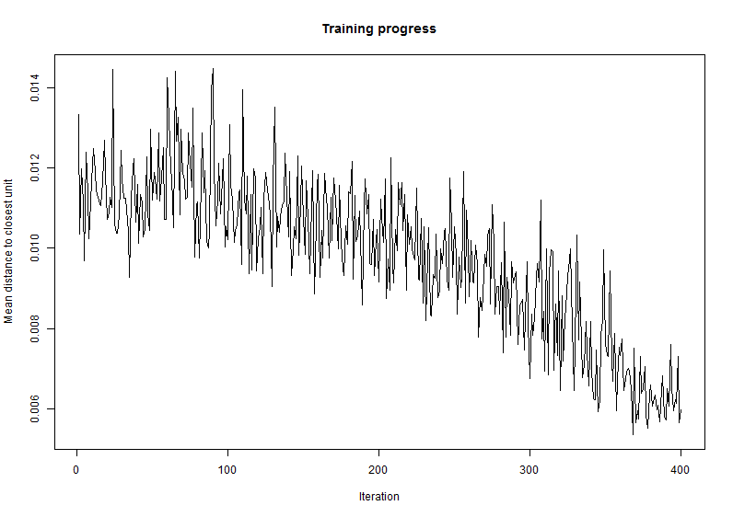
Plot learning rate: computed distances between centroids/nodes and data

Slide 11
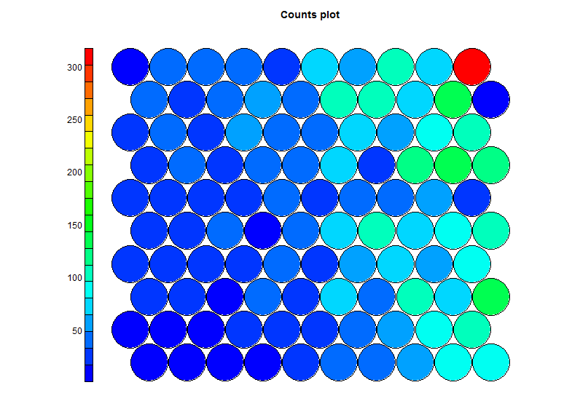
Plot the number of data points mapped to each node
91
100
NODE | COUNT
100 | 317
89 | 143
30 | 139
69 | 130
68 | 118
70 | 115
28 | 105
86 | 103
80 | 100
20 | 99
50 | 99
87 | 99
98 | 97
47 | 96
40 | 95
10 | 86
79 | 85
49 | 82
9 | 81
1, 2, 3…
10

Slide 12
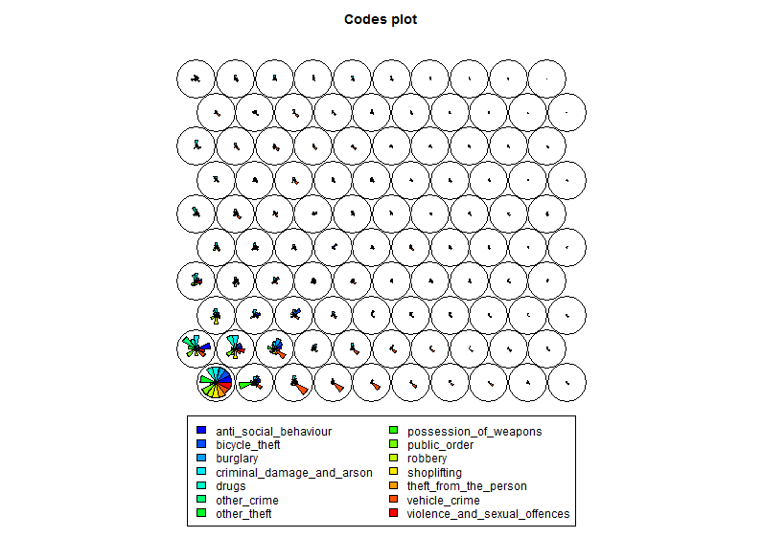
Node vectors represented by a segments plot
Highest crimes associated with the bottom left corner nodes

Slide 13
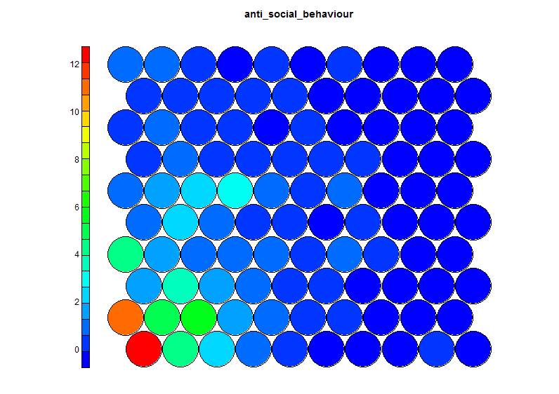
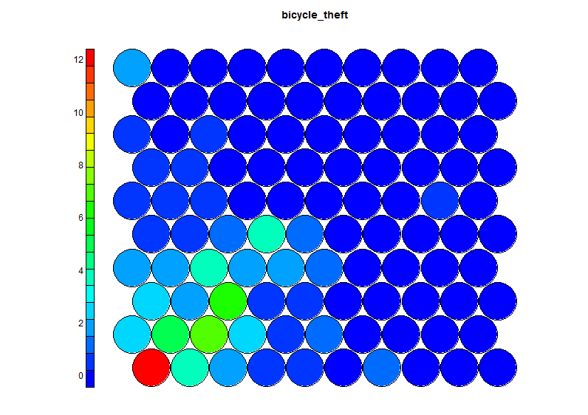
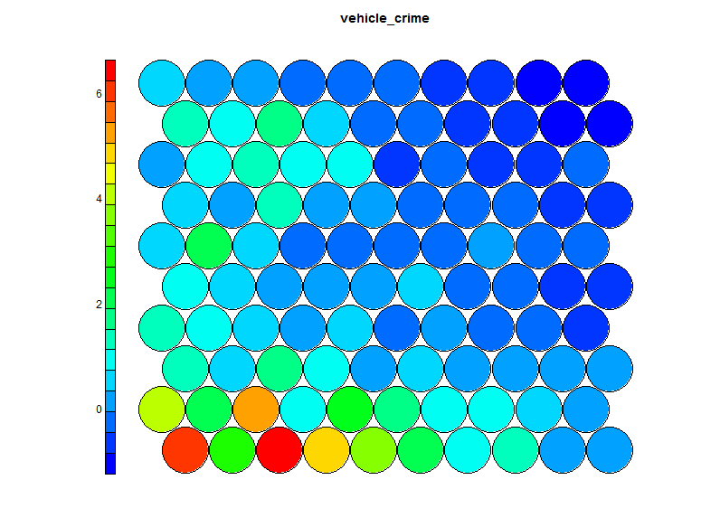
Better visualisation of 6 variables or more using individual heatmaps
Node 1 featuring highest recordings of most crimes
Frequency table indicates 6 areas mapped to node 1:
City of London 001F
Newham 013G
Westminster 013B
Westminster 013E
Westminster 018A
Westminster 018C

Slide 14
Node 1 also represents the highest bicycle theft rates: 6 areas mapped to node 1
AREA | BICYCLE THEFT
City of London 001F | 216
Newham 013G | 112
Westminster 013B | 81
Westminster 013E | 64
Westminster 018A | 53
Westminster 018C | 66
Average bicycle theft: 3.59
Node 3 represents the highest vehicle crime rates: 10 areas mapped to node 3
AREA | VEHICLE CRIME
Kensington and Chelsea 012A | 163
Ealing 015E | 130
Enfield 033F | 134
Newham 033B | 115
Average vehicle crime: 17.36

Slide 15
Conclusion
Shiny application showed a geographic representation of crime incidences
SOM are effective in clustering and segmentation
Ability to identify areas of similar crimes
Identify areas with higher levels of certain types of crime e.g. “bicycle theft” and “vehicle crime”
Further analysis
Train a SOM with fewer variables for less generalisation and higher accuracy
Map untrained data to the trained SOM (using the prediction method)

